Slide 1
Measure of Impurity: GINI
Maximum (0.5) when records are equally distributed among 2 classes, implying least information gain from the split
Minimum (0.0) when all records belong to one class, implying most information gain from the split

Slide 2
Model Evaluation
Metrics for Performance Evaluation
How to evaluate the performance of a model?
Methods for Performance Evaluation
How to obtain reliable estimates?
Methods for Model Comparison
How to compare the relative performance among competing models?

Slide 3
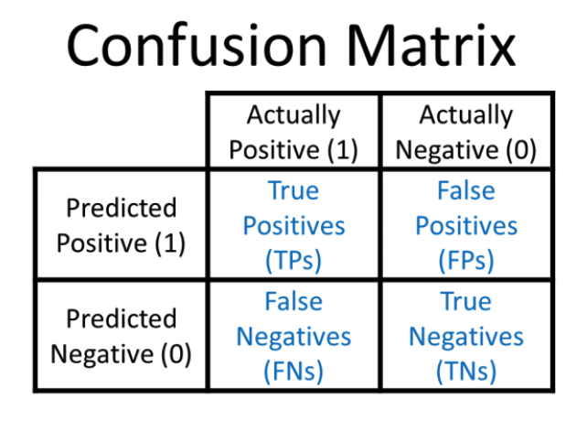

Slide 4
Confusion Matrix Components
Test dataset
Validation dataset with expected outcome values.
Make a prediction for each row in your test dataset.
From the expected outcomes and predictions count:
The number of correct predictions for each class.
The number of incorrect predictions for each class, organized by the class that was predicted.

Slide 5
Metrics for Performance Evaluation…
 | PREDICTED CLASS
ACTUAL CLASS |  | Class=Yes | Class=No
 | Class=Yes | a (TP) | b (FN)
 | Class=No | c (FP) | d (TN)
Most widely-used metric:

Slide 6
Limitation of Accuracy
Consider a 2-class problem
Number of Class 0 examples = 9990
Number of Class 1 examples = 10
If model predicts everything to be class 0, accuracy is 9990/10000 = 99.9 %
Accuracy is misleading because model does not detect any class 1 example

Slide 7
ROC (Receiver Operating Characteristic)
Developed in 1950s for signal detection theory to analyze noisy signals
Characterize the trade-off between positive hits and false alarms
ROC curve plots TP (on the y-axis) against FP (on the x-axis)
Performance of each classifier represented as a point on the ROC curve

Slide 8
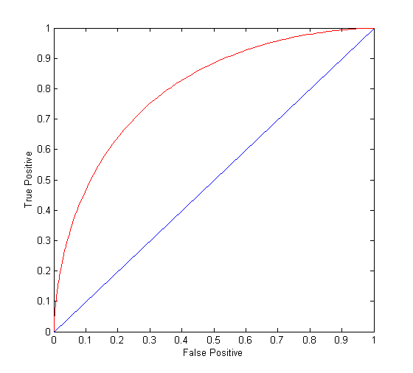
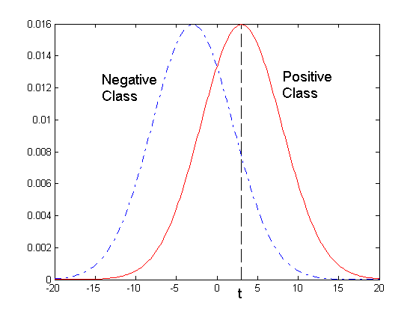
ROC Curve
- 1-dimensional data set containing 2 classes (positive and negative)
- any points located at x > t is classified as positive
At threshold t:
TP=0.5, FN=0.5, FP=0.12, FN=0.88

Slide 9
ROC Curve
(TP,FP):
(0,0): declare everything to be negative class
(1,1): declare everything to be positive class
(1,0): ideal
Diagonal line:
Random guessing
Below diagonal line:
prediction is opposite of the true class

